Slide 1
Chapter 2. LAN & WLAN

Slide 2
Contents
LAN
Some concepts: collosion domain, broadcast domain
Devices: Hub, Switch, Router
SOHO & Enterprise LAN
Ethernet standards
Cabling : T568-A, T568-B
WLAN
WLAN standards
WLAN models: Ad-hoc, BSS, ESS, Mesh
WLAN security

Slide 3
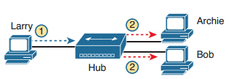
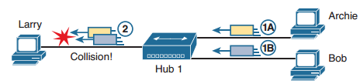
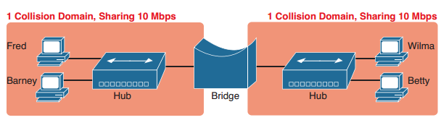
Some Concepts
Collision domain
A collision domain is the set of NICs and device ports for which if they sent a frame at the same time, the frames would collide

Slide 4
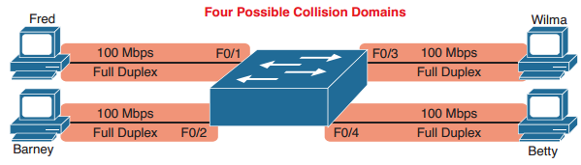
Switch Creates Four Collision Domains and Four Ethernet Segments
LAN switches place each separate interface into a separate collision domain.
LAN bridges, which use the same logic as switches, placed each interface into a separate collision domain.
Routers place each LAN interface into a separate collision domain. (The term collision domain does not apply to WAN interfaces.)
LAN hubs do not place each interface into a separate collision domain.
A modern LAN, with all LAN switches and routers, with full duplex on each link, would not have collisions at all.
In a modern LAN with all switches and routers, even though full duplex removes collisions, think of each Ethernet link as a separate collision domain when the need to troubleshoot arises.
Summarizing the key points about collision domains:

Slide 5
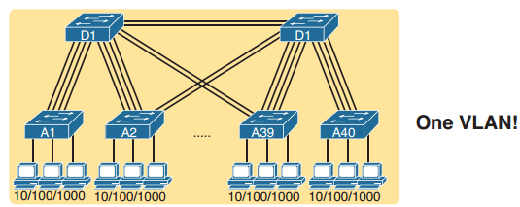
Some Concepts
Broadcast domain
An Ethernet broadcast domain is the set of devices to which that broadcast is delivered
A broadcast sent by any one device would be flooded to all devices connected to all switches
A Single Large Broadcast Domain

Slide 6
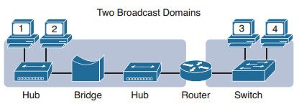
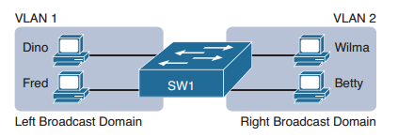
Broadcast Domains Separated by a Router
A LAN consists of all devices in the same broadcast domain
Virtual LANs (VLANs)
The switches create multiple broadcast domains by putting some interfaces into one VLAN and other interfaces into other VLANs.
Sample Network with Two VLANs using One Switch

Slide 7
Summarizing the main points about broadcast domains:
Broadcasts exists, so be ready to analyze a design to define each broadcast domain, that is, each set of devices whose broadcasts reach the other devices in that domain.
VLANs by definition are broadcast domains created though configuration.
Routers, because they do not forward LAN broadcasts, create separate broadcast domains off their separate Ethernet interfaces.

Slide 8
Analyzing Campus LAN technologies
The term campus LAN refers to the LAN created to support the devices in a building or in multiple buildings in somewhat close proximity to one another
The network engineers can then build a campus LAN that includes switches in each building, plus Ethernet links between the switches in the buildings, to create a larger campus LAN.

Slide 9
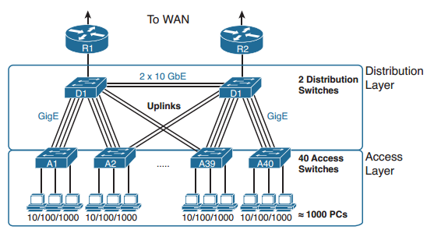
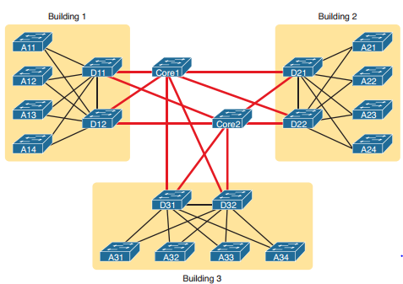
Two-Tier Campus Design (Collapsed Core)
Three terms to describe the role of each switch in a campus design: access, distribution, and core.
Access: Provides a connection point (access) for end-user devices. Does not forward frames between two other access switches under normal circumstances.
Distribution: Provides an aggregation point for access switches, providing connectivity to the rest of the devices in the LAN, forwarding frames between switches, but not connecting directly to end-user devices.
Core: Aggregates distribution switches in very large campus LANs, providing very high forwarding rates for the larger volume of traffic due to the size of the network
Three-Tier Campus Design (Core)

Slide 10
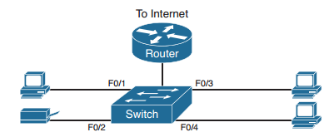
SOHO LANs
SOHO: Small Office/Home Office

Slide 11
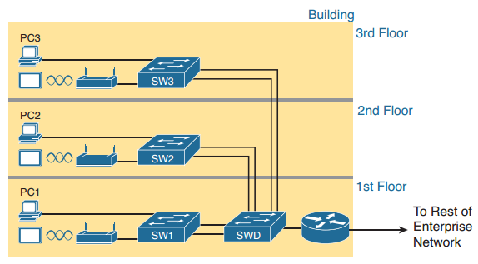
Enterprise LANs
Enterprise networks have similar needs compared to a SOHO network, but on a much larger scale

Slide 12

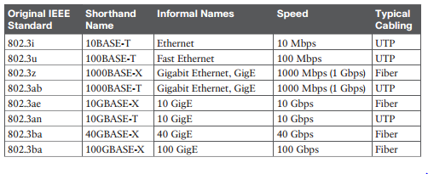
Ethernet Standards
The term Ethernet refers to an entire family of standards. Some standards define the specifics of how to send data over a particular type of cabling, and at a particular speed. Other standards define protocols, or rules, that the Ethernet nodes must follow to be a part of an Ethernet LAN. All these Ethernet standards come from the IEEE and include the number 802.3 as the beginning part of the standard name.
Ethernet physical standards

Slide 13
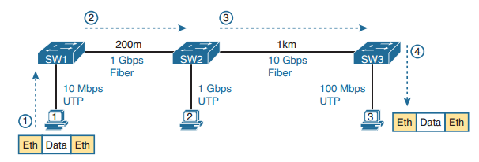
Ethernet Standards (cont.)
Ethernet Data Link Layer
While the physical layer standards focus on sending bits over a cable, the Ethernet data-link protocols focus on sending an Ethernet frame from source to destination Ethernet node. The term frame specifically refers to the header and trailer of a data-link protocol, plus the data encapsulated inside that header and trailer.

Slide 14
What is an Ethernet LAN?
It is a combination of user devices, LAN switches, and different kinds of cabling. Each link can use different types of cables, at different speeds.
However, they all work together to deliver Ethernet frames from the one device on the LAN to some other device.

Slide 15
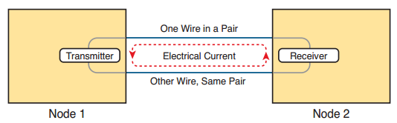
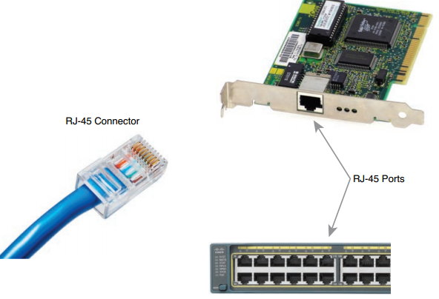
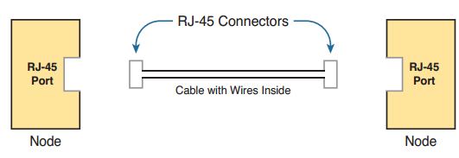
Building Physical Ethernet Network with UTP
To send data, the two devices follow some rules called an encoding scheme. The idea works a lot like when two people talk using the same language: The speaker says some words in a particular language, and the listener, because she speaks the same language, can understand the spoken words.
Basic Components of an Ethernet Link

Slide 16
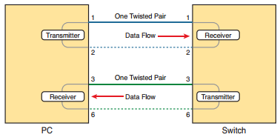
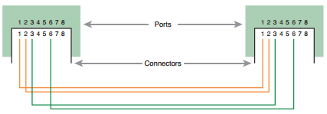
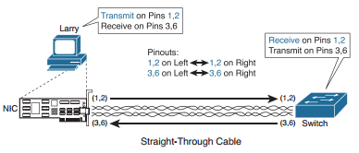
Straight-Through Cable

Slide 17
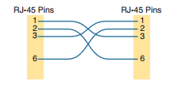

Crossover Ethernet Cable

Slide 18
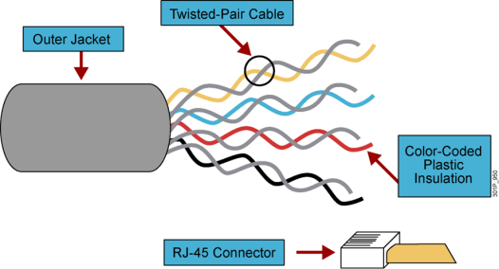
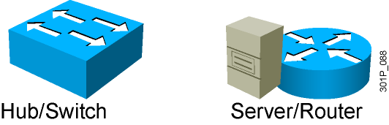
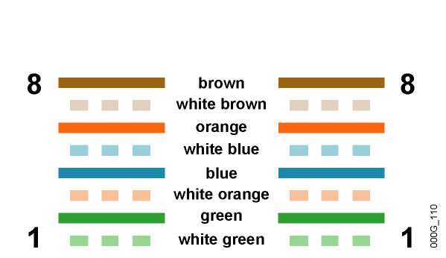
UTP Implementation (Straight-Through)
Straight-Through Cable
Pin Label
Pin Label
1
2
3
4
5
6
7
8
TX+
TX-
RX+
NC
NC
RX-
NC
NC
1
2
3
4
5
6
7
8
TX+
TX-
RX+
NC
NC
RX-
NC
NC
Wires on cable ends are in same order.
Notes:
Lesson Aim
<Enter lesson aim here.>

Slide 19
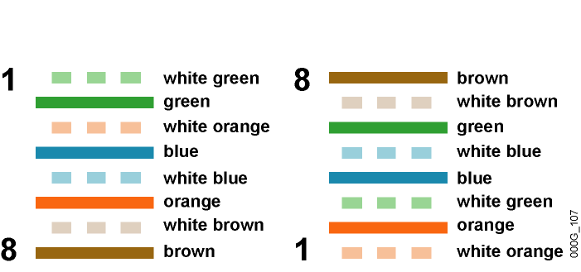
UTP Implementation (Crossover)
Crossover Cable
EIA/TIA T568A
EIA/TIA T568B
Pin Label
Pin Label
1
2
3
4
5
6
7
8
TX+
TX-
RX+
NC
NC
RX-
NC
NC
1
2
3
4
5
6
7
8
TX+
TX-
RX+
NC
NC
RX-
NC
NC
Notes:
Lesson Aim
<Enter lesson aim here.>

Slide 20

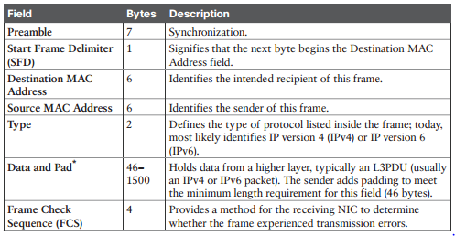
Ethernet Data Link protocol
Commonly Used Ethernet Frame Format

Slide 21
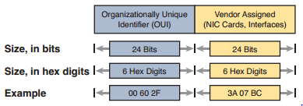
Ethernet Addressing
Ethernet addresses, also called Media Access Control (MAC) addresses, are 6-byte-long (48-bitlong) binary numbers
Most MAC addresses represent a single NIC or other Ethernet port, so these addresses are often called a unicast Ethernet address.
Structure of Unicast Ethernet Addresses

Slide 22
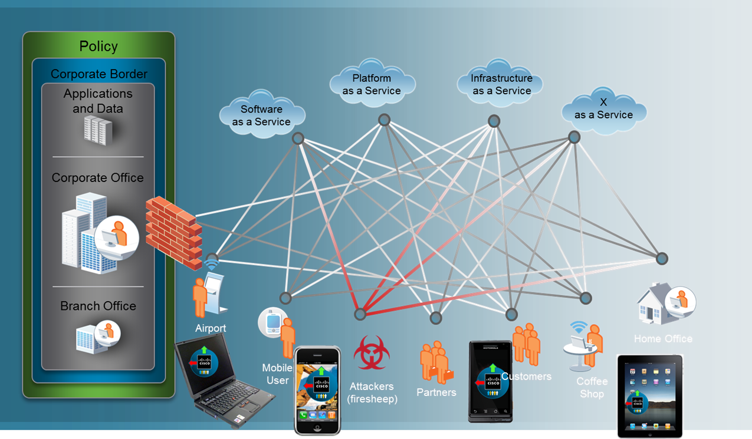
Wireless LANs (WLANs)
Today’s wireless network

Slide 23
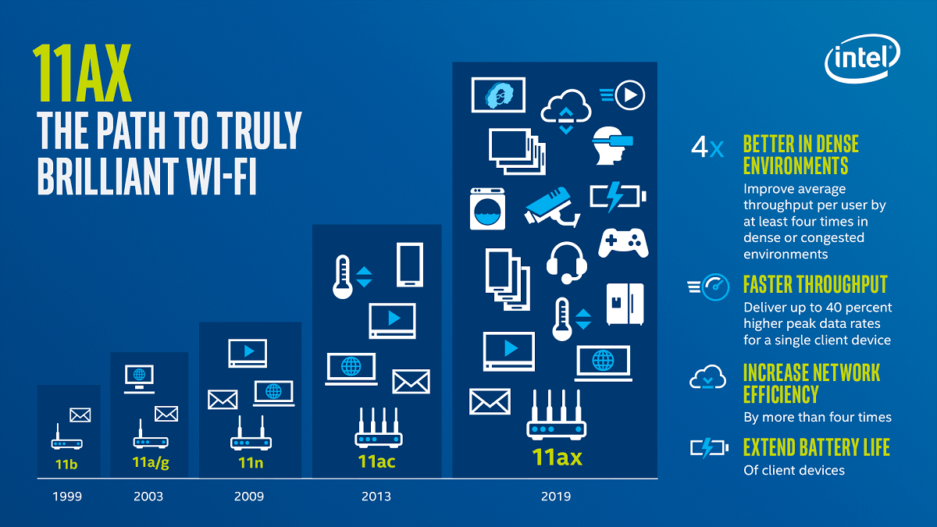
Wireless LANs (WLANs)

Slide 24
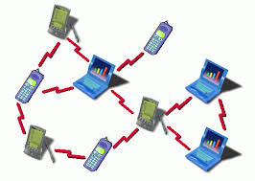
WLAN models
Ad hoc wireless LANs
“peer-to-peer” WLANs
Independent Basic Service Set (IBSS)

Slide 25


WLAN models
Infrastructure wireless LANs
Access Point
Basic Service Set (BSS) –
Single cell
Station
Extended Service Set (ESS) –
Multiple cells

Slide 26
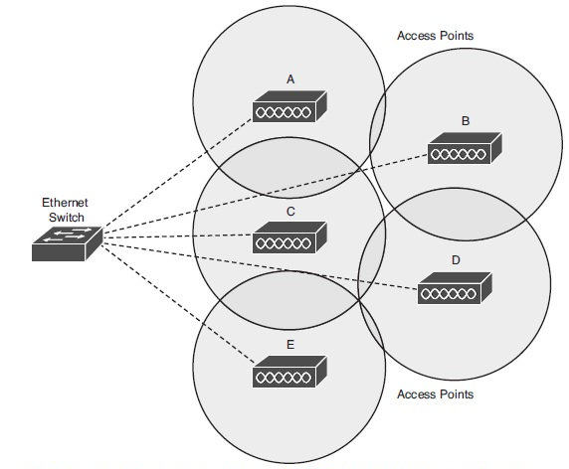
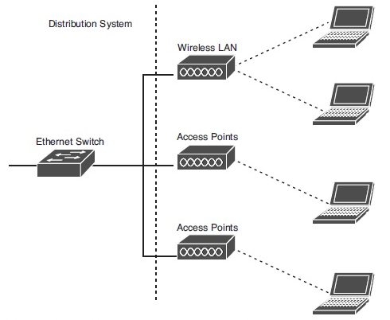
WLAN models
Multicell WLAN with overlapping cells supports roaming

Slide 27
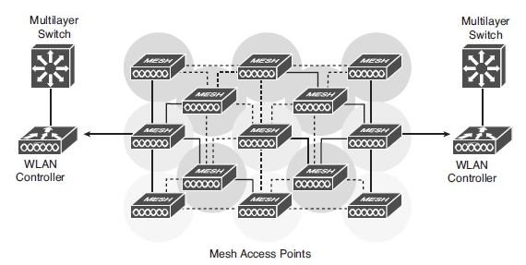
Wireless mesh networks

Slide 28
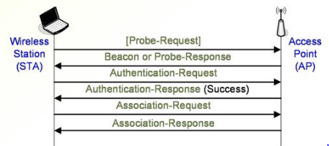
Join a wireless LAN
AP sends becons, usually every 50-100 ms
Beacons usually include the SSID but the SSID broadcast can be turned off
STA must specify SSID to the AP in association request

Slide 29
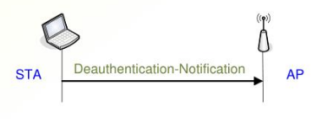
Leaving a wireless LAN
Both STA and AP can send a Deassociation Notification or Deauthentication Notification

Slide 30
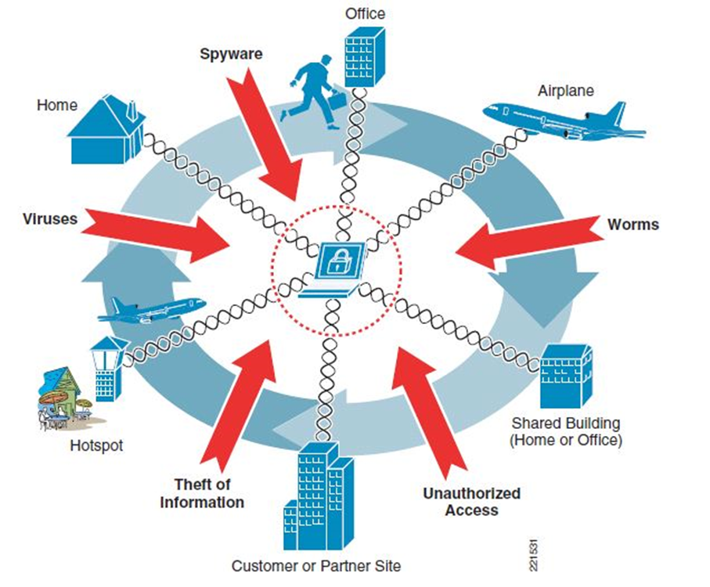
WLAN security

Slide 31
WLAN security
WLAN security goals
Data confidentiality and integrity: prevent sniffing and spoofing of data on the wireless link
Access control: allow access only for authorized wireless stations
Accouting: hotspot operates may want to meter network usage
Authentication: access control and accounting usually depend on knowing the identity of the wireless station or user
Availability: do not make denial-of-service attacks easy

Slide 32
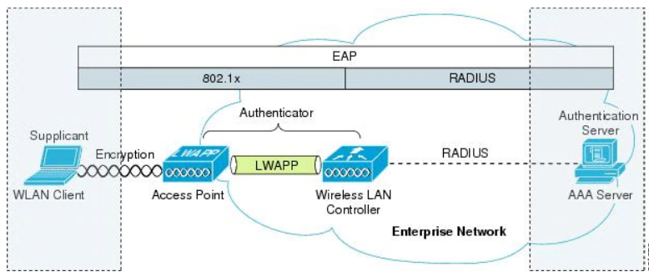
Some solutions
MAC Address Filtering
Wi-Fi Encryption: WPA2, WPA3
802.1X
…

Slide 33
Q&A

